Slide 1









High Quality Protein Q8 Secondary Structure
Prediction by Diverse Neural Network Architectures

Slide 2




Team MEMBERS
MOhd Sufyan Azam
Jai Singh
Sumit soni

Slide 3



Abstract
This is a study on predicting protein secondary structures at Q8 resolution using a variety of neural network architectures.
It achieves high accuracy, comparable to the top existing models, and emphasizes reproducible research by making data, models, and code publicly available.
The focus is on addressing long-standing errors in dataset splits and introducing new methods for enhanced prediction in computational biology.

Slide 4

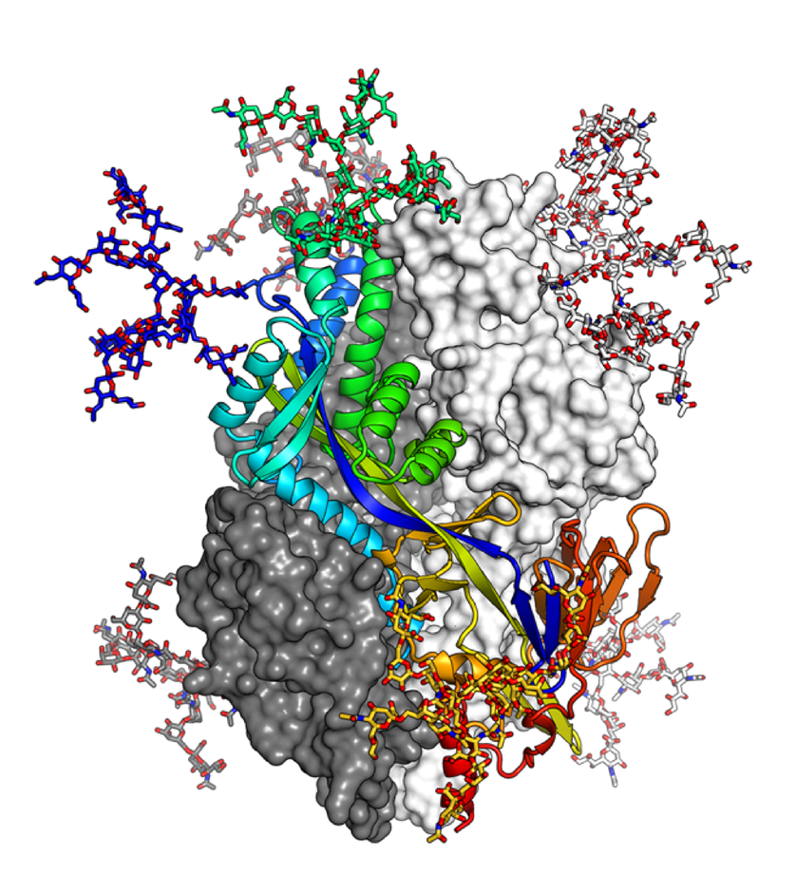

Importance of Protein Structures
Proteins, as fundamental building blocks of life, perform essential biological functions derived from their 3D structures.
Protein sequences are diverse, evolving over billions of years, which dictates their complex spatial conformations.
Predicting 3D protein structures from amino acid sequences has been a significant challenge in computational biology for over 50 years.
Secondary structure prediction is a critical first step in understanding protein structures and functions.

Slide 5
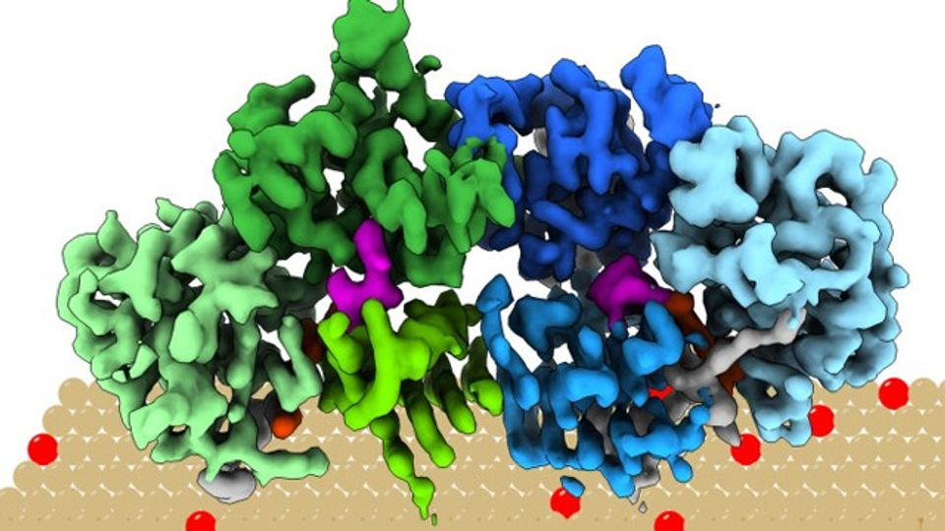
Background
Protein structures dictate biological functions and are determined by amino acid sequences.
The problem of predicting protein 3D structures from sequences (Protein Structure Prediction, PSP) has been pursued for decades.
Early efforts in secondary structure prediction focused on simplifying the problem to predicting fewer structural classes using statistical methods.
Recent advancements involve deep learning techniques, improving the accuracy and reliability of predictions at higher resolutions like Q8.
This study builds on past research, aiming to enhance prediction accuracy using innovative neural network architectures.

Slide 6

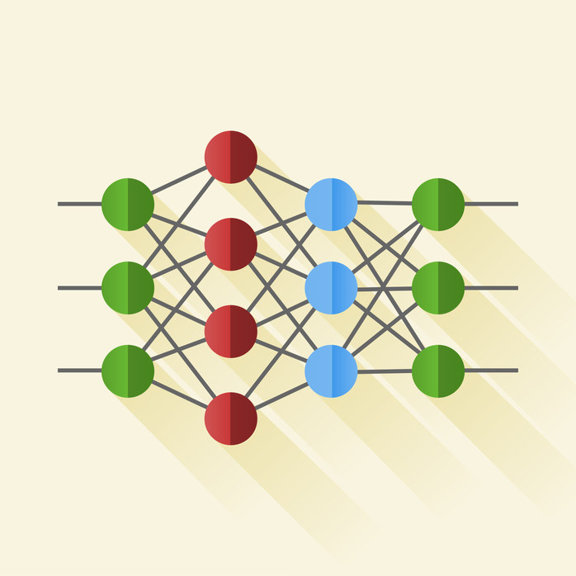




Objectives
Implement diverse neural network architectures to predict protein secondary structures at Q8 resolution.
Achieve high accuracy in predictions, comparing favorably with top existing models.
Address and correct longstanding dataset errors to set new standards for future research in computational biology.

Slide 7



DATA AND TRAINING APPROACH
01
Utilized the CB6133 dataset, focusing on high-quality and error-free data handling.
02
Corrected historical inaccuracies in dataset splits, ensuring valid and unbiased performance evaluation.
03
Adopted robust machine learning protocols to minimize overfitting and enhance generalization across tests.
04
Results derived from a comprehensive set of neural network models demonstrated substantial improvements over traditional methods.

Slide 8
DL Architectures used
Bidirectional LSTMs with Attention.
Bidirectional GRU with Convolutional Blocks.
Temporal Convolutional Network (TCN).
Bidirectional GRU with 2D Convolution.

Slide 9
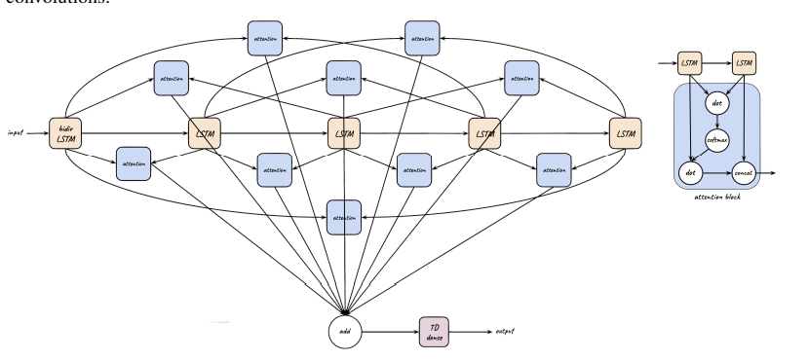
Bidirectional LSTMs with Attention

Slide 10
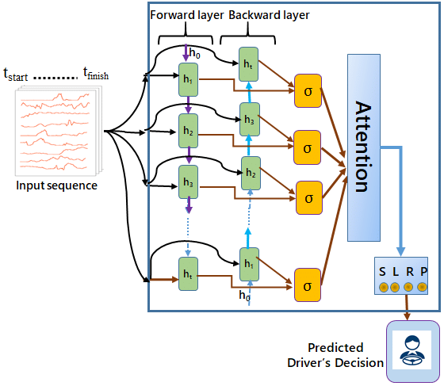
Bidirectional LSTMs with Attention
Results:
Mean Accuracy on CB513 dataset: 68.4%
Hyperparameters:
Optimizer: RMSprop
Learning Rate: 0.003
Decay: 0.5
Epochs: 20
Batch Size: 64

Slide 11
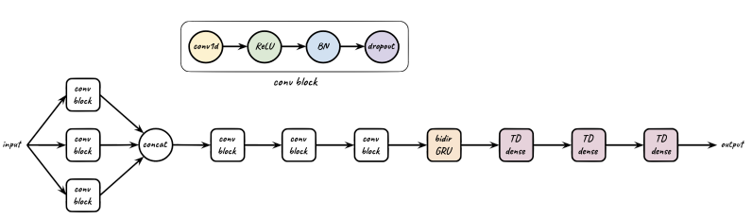
Bidirectional GRU with Convolutional Blocks.

Slide 12
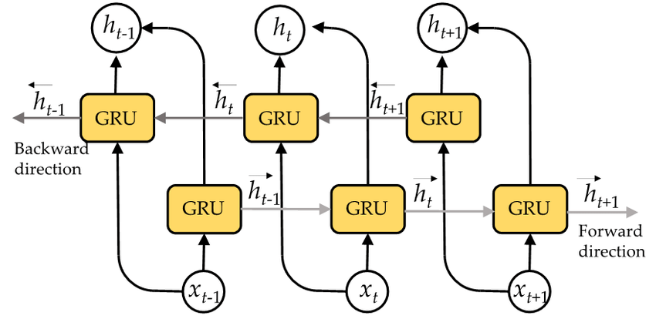
Bidirectional GRU with Convolutional Blocks.
Results:
Mean Accuracy on CB513 dataset: 69.8%
Mean Accuracy on CB6133 dataset: 74.8%
Hyperparameters:
Optimizer: Nadam
Learning Rate: 0.002
Decay: 0.004
Epochs: 75
Batch Size: 128

Slide 13
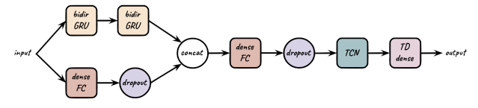
Temporal Convolutional Network (TCN)

Slide 14
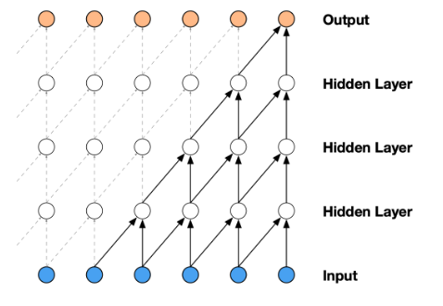
Temporal Convolutional Network (TCN)
Results:
Mean Accuracy on CB513 dataset: 68.7%
Mean Accuracy on CB6133 dataset: 75.4%
Hyperparameters:
Optimizer: Adam
Learning Rate: 0.001
Decay: 0.0001
Epochs: 5
Batch Size: 16

Slide 15
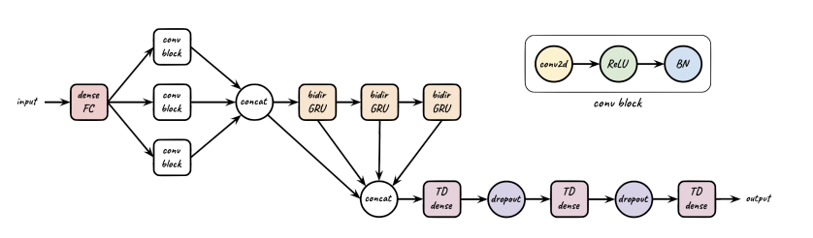
Bidirectional GRU with 2D Convolution

Slide 16
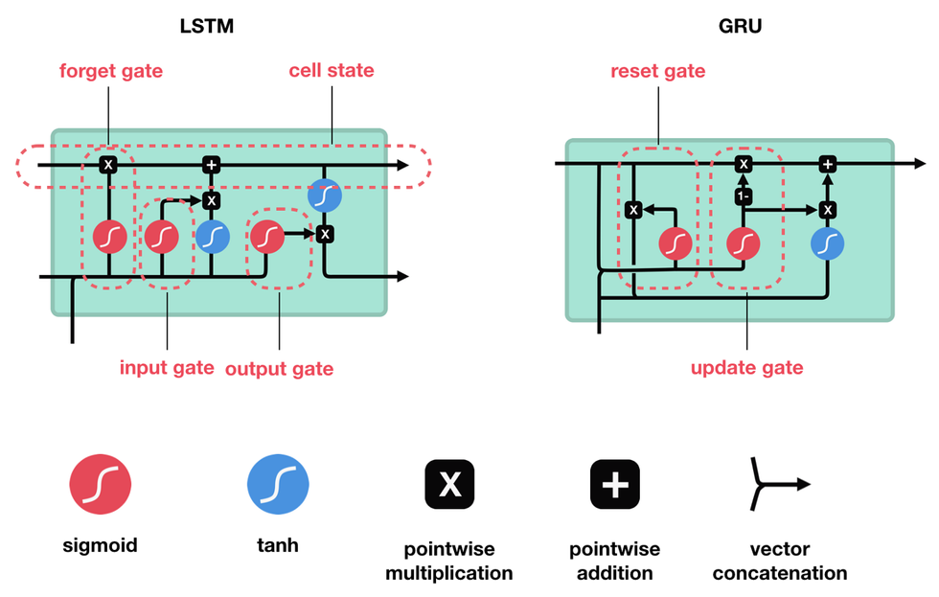
Bidirectional GRU with 2D Convolution
Results:
Mean Accuracy on CB6133 dataset: 72.9%
Hyperparameters:
Optimizer: Nadam
Learning Rate: 0.002
Decay: 0.004
Epochs: 10
Batch Size: 64

Slide 17
Result
Bidirectional LSTMs with Attention: 67.60 % ( Mean Accuracy )
Bidirectional GRU with Convolutional Blocks : 72.04%( on Cs513 ) ( Mean Accuracy )
Temporal Convolutional Network : 73.25 % ( Mean Accuracy )
Bidirectional GRU with 2D Convolution: 68.30% ( Mean Accuracy )

Slide 18
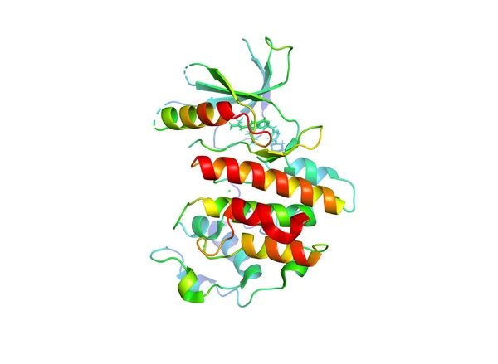
Conclusion
The study introduced innovative neural network architectures for protein secondary structure prediction, achieving state-of-the-art accuracy.
Demonstrated effective handling and correction of dataset errors, improving the reliability of model evaluations.

Slide 19
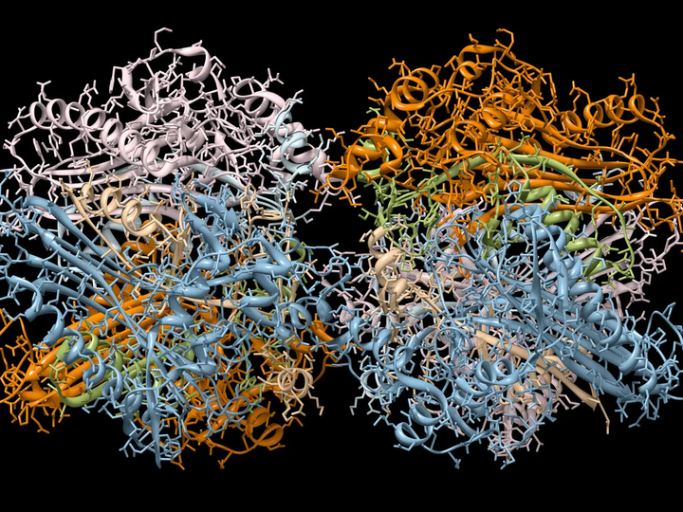
FUTURE WORK
Explore additional neural network configurations and deeper architectures to further enhance prediction accuracy.
Incorporate larger and more diverse datasets to test the scalability and robustness of the models.
Develop real-time applications and tools that utilize these models for practical bioinformatics research and therapeutic developments.

Slide 20
References
Link for the paper -
https://arxiv.org/pdf/1811.07143v1
Link for its code -
https://github.com/SAINTProtein/MUFOLD-SS

Slide 21
Thank You

